Slide 1
Dynamic Programming
Riry & André

Slide 2
The 3 tasks
Inventory planning
Packing products
Delivery planning

Slide 3
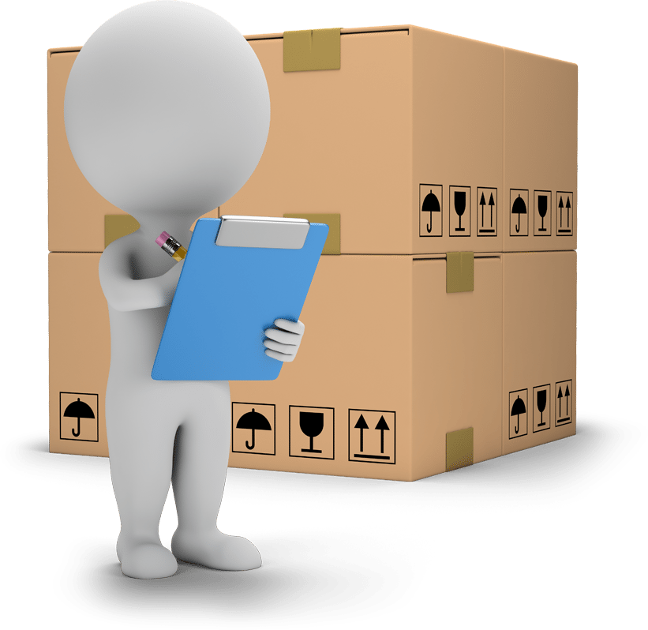
Inventory Planning
Determine the minimum capacity needed to store all of the supplies before they are shipped.

Slide 4
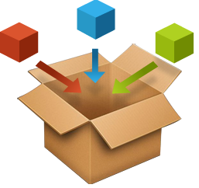
Packing products
Pack a single container as densely as possible or pack all objects using as fell containers as possible.

Slide 5
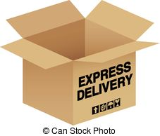
Delivery planning
Find the optimal set of rules in order to delivery to a given set of customers.

Slide 6
DP to all problems? Are you sure?
Delivery Planning
(shortest path problem)
Packing Products
(knapsack problem)
Inventory Planning
(time optimal control)

Slide 7
About Dynamic Programming
Is a way to solve a complex problem by breaking it down into a collection of simpler sub-problems
Overlapping sub-problems
Top-down and bottom-up approaches
1950
2000
timeline

Slide 8
Let’s solve Inventory Planning
A B2B client creates an order for the next 4 months
The items are delivered at the end of each month
We are able to produce 400 items a month
If we produce more than 200 items in any month, we need to hire more staff at $4000 per month
Stock carry over from one month to another costs $500 a month for each 100 items
We have zero items in stock now and we plan to have zero items in stock at the end of December
 | Sep | Oct | Nov | Dec
Items schedule for delivery | 100 | 500 | 200 | 300

Slide 9
Overlapping sub-problems
100
200
Start
End
300
400

Slide 10
Thanks!

